Slide 1


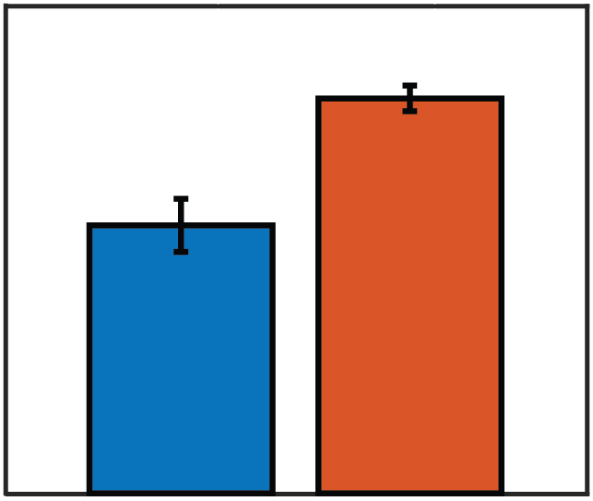
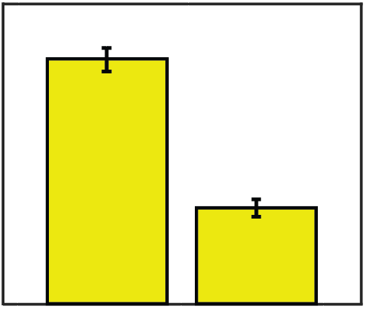
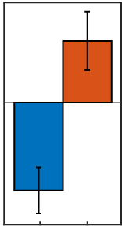
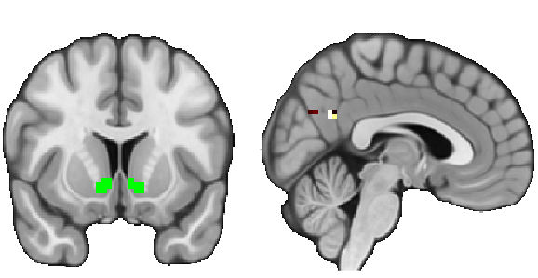
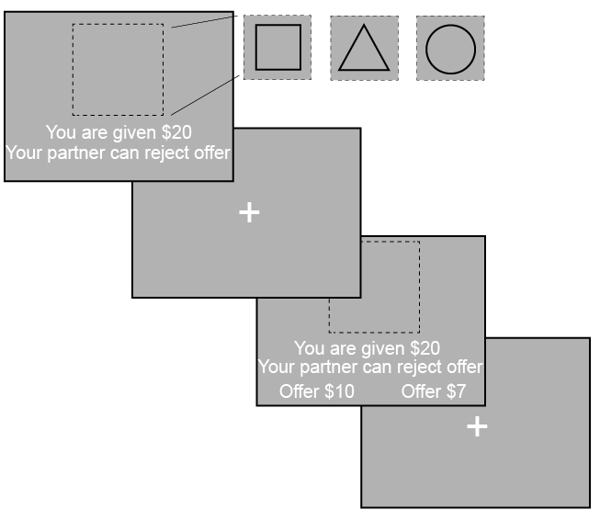
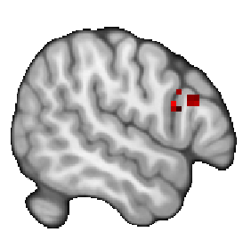
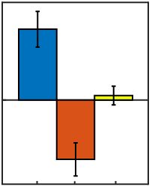


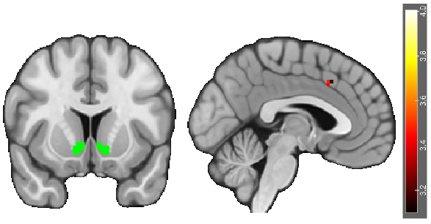
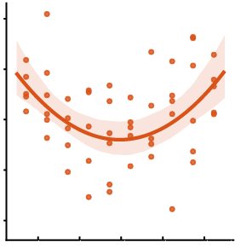
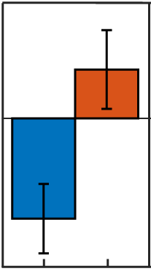

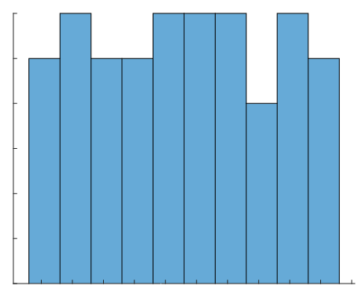
When Do We Choose to Be Fair? Strategic Choices in Bargaining Situations
Are Associated with Elevated Corticostriatal Connectivity
Daniel Sazhin¹, Jeffrey Dennison¹, James Wyngaarden¹, Athena Vafiadis¹, Ori Zaff¹ , Neriah Kahn¹, Makayla Collins¹, Amanda Nguyen¹, Ishika Kohli¹, Dominic Fareri², Michael McCloskey¹, Lauren Alloy¹, Johanna Jarcho¹, David V. Smith¹
1. Temple University, Philadelphia, PA; 2. Adelphi University, Garden City, NY
1. Introduction
3. Behavioral Results Indicate Subjects Act Strategically
6. Corticostriatal Connectivity Underlying Strategic Behavior
To assess if people behaved strategically as proposers, we used a mixed effects model.
People act strategically, with fairness in bargaining situations associated with the activation in the caudate and dorsolateral prefrontal cortex (Spitzer et al., 2007).
People who are hypo and hypersensitive to rewards are at greater risk of substance use disorders (Alloy et al., 2007).
Substance use often happens in social contexts, with relapse triggered by peer rejection (Marlatt & Donovan, 2007).
However, little is known about the associations of reward sensitivity and corticostriatal connectivity in social contexts.
Proportion of Endowment Offered (0-1)
Proportion of Endowment Offered (0-1)
Proposer Conditions
0.4
Recipient Conditions
We investigated connectivity between a VS seed and other possible target regions during strategic behavior.
0.3
0.3
Seed Region: Ventral Striatum
Target Region: PCC
VS-PCC Connectivity (β)
Parametric Effect of Fairness
2.0
0.2
0.2
1.0
0.1
0.1
0
-1.0
We investigated whether aberrant reward sensitivity and neural responses are related to strategic behavior.
0
0
-2.0
Dictator Game
Ultimatum Game
Accept
Reject
X=4
DG-P
UG-P
2. Methods
Using a mixed effects model, we found that task as a proposer predicts decisions. A binary logistic regression showed that participants reject more with lower offers.
Y=12
As participants made fairer offers while making strategic decisions (UG > DG), we found enhanced effective connectivity between a VS seed and Posterior Cingulate Cortex (PCC) target.
The Ultimatum (UG) and Dictator (DG) Games were used to assess neural and behavioral responses to perceived fairness. We defined strategic behavior as the difference in offers (high vs. low) in the proposer conditions.
4. Activation during Strategic Decisions
We replicated previous findings (Spitzer et al., 2007) during strategic decisions.
7. Aberrant Reward Sensitivity Modulates Corticostriatal Connectivity Underlying Fairness
IFG
IFG Activation (β)
Parametric Effect of Fairness
150
We investigated associations between reward sensitivity, fairness, and connectivity between a VS seed and possible target regions.
100
VS-ACC Connectivity (β)
Parametric Effect of Fairness
UG Proposer
DG Proposer
UG Recipient
50
Seed Region: Ventral Striatum
Target Region: ACC
10
Scan the QR code to see the
Pre-registration!
0
5
-50
0
Endowment
Phase (1s)
-100
-5
X=54
DG-P
UG-P
UG-R
-10
-4
-2
0
2
4
ISI
(jittered 1-8s)
As participants proposed fairer offers during strategic decisions (DG-P > UG-P), we found increasing activation in the Inferior Frontal Gyrus (IFG).
Y=12
X=-3
Composite Reward
As participants with aberrant reward sensitivity made fairer offers, they expressed stronger effective connectivity between a VS seed and an Anterior Cingulate Cortex (ACC) target.
Proposers offer a high/low split
Recipients accept or reject offers
In UG, offers could be rejected and both partners earn $0
5. Strategic Decisions Enhance VS-pTPJ Connectivity
Decision
Phase 3s
During strategic decisions (DG-P > UG-P), we expected that elevated ventral striatal (VS) responses will be associated with enhanced effective connectivity in the posterior temporoparietal junction (pTPJ).
8. Conclusions and Future Directions
VS-pTPJ Connectivity (β)
Parametric Effect of Fairness
We found that the VS has stronger connectivity with the pTPJ and PCC while making strategic decisions.
Effective connectivity between the VS and ACC tracks fairness, modulated by reward sensitivity.
Future investigations could assess corticostriatal connectivity and substance use in a clinical population.
N = 54 completed the Behavioral Activation System (Carver & White, 1994) and Sensitivity to Reward (Torrubia & Tobeña, 1984) questionnaires.
Seed Region: Ventral Striatum
A Priori ROI
Target: pTPJ
0.8
ITI
(jittered 1.5-4.5s)
0.4
0
Frequency
6
-0.4
Whole brain results were thresholded at Z > 3.1 and Family Wise Error corrected at p > .05
Masks were extracted from Harvard–Oxford and Mars atlases.
-0.8
Our findings help to characterize the role of corticostriatal connectivity in
social decision making.
3
-1.2
UG-P
Y=12
X=50
DG-P
0
5
As participants made fairer offers while making strategic decisions (UG > DG), we found enhanced VS effective connectivity with the pTPJ.
-5
0
This study was supported by a grant from the National Institutes of Health (R03-DA046733 (DVS). Contact information for Daniel Sazhin: daniel.sazhin@temple.edu.
Composite Reward Sensitivity

